Slide 1
Case Study 1
Prepared By:
Andrew Walch
Joshua Hudson

Slide 2
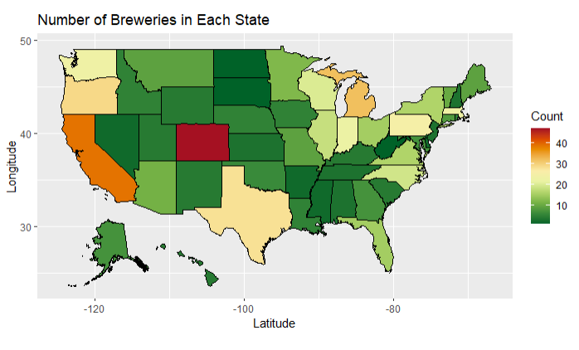
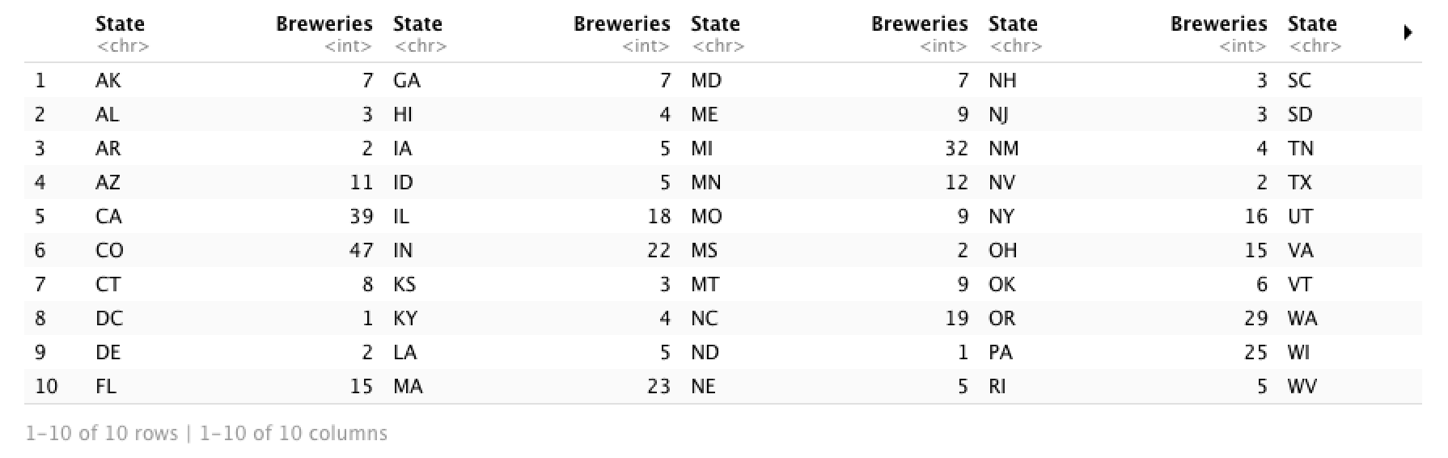
American Brewery Distribution
Colorado had the most breweries in the USA.
Washington DC, Delaware, and North Dakota tied in having the least breweries in the USA

Slide 3
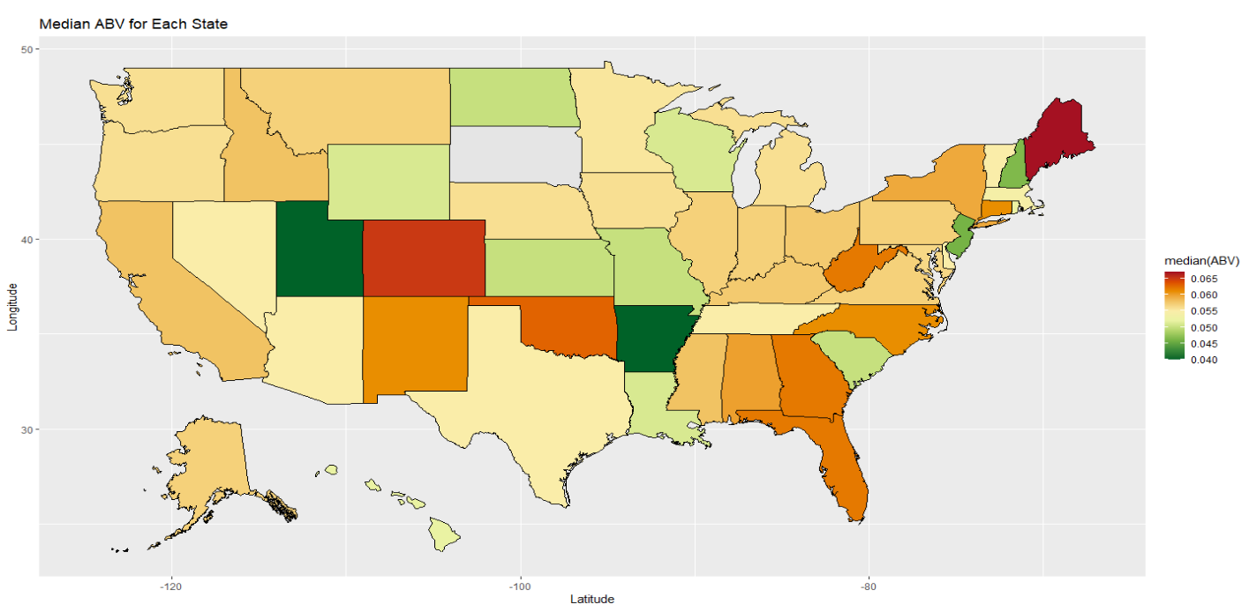
Median ABV for Each State
Maine had the highest ABV median in the USA ~ 0.067
Brewery with the max AVB was in KY ~ 0.125

Slide 4
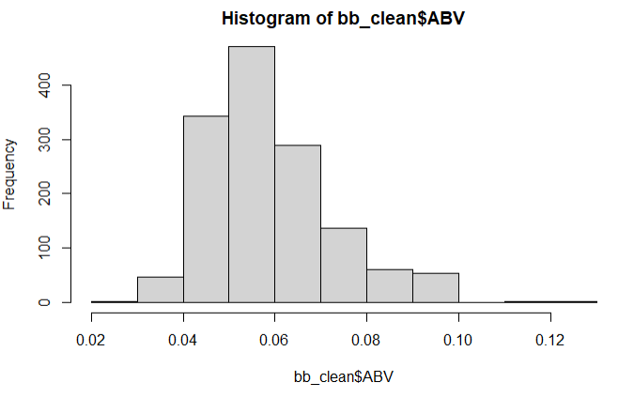
Nationwide ABV Distribution
The ABV values does not closely follow a normal distribution. In fact, it is slightly skewed right with a mean of 0.060 and median of 0.057. This implies that there are other variables that are influencing the ABV values for beers across the country. This information begs to be further analyzed to find other factors that influence ABV values.

Slide 5
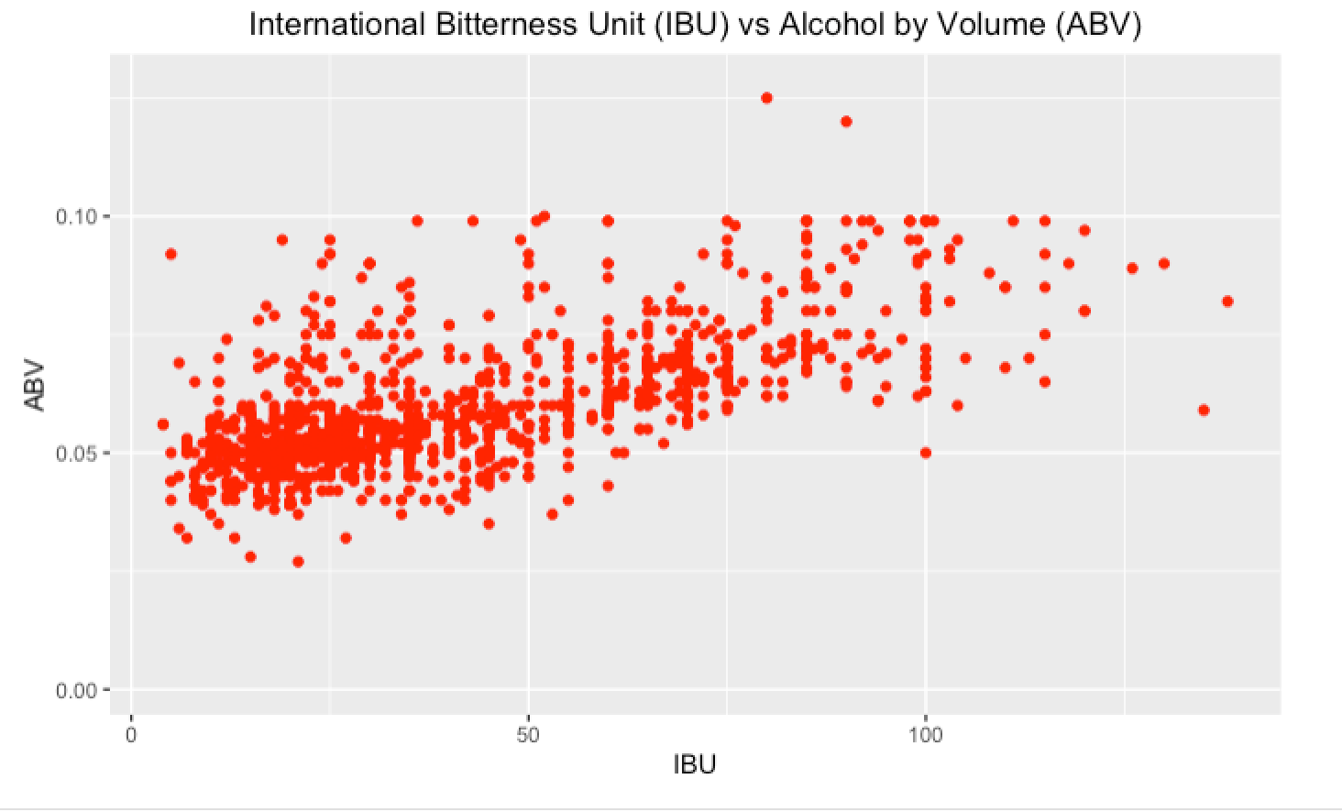
IBU vs ABV
Because the p-value of the test is 2.2e-16, which is less than the significance level alpha = 0.05. We can conclude that IBU and ABV are significantly correlated with a correlation coefficient of 0.6707224 and p-value of 2.2e-16.

Slide 6
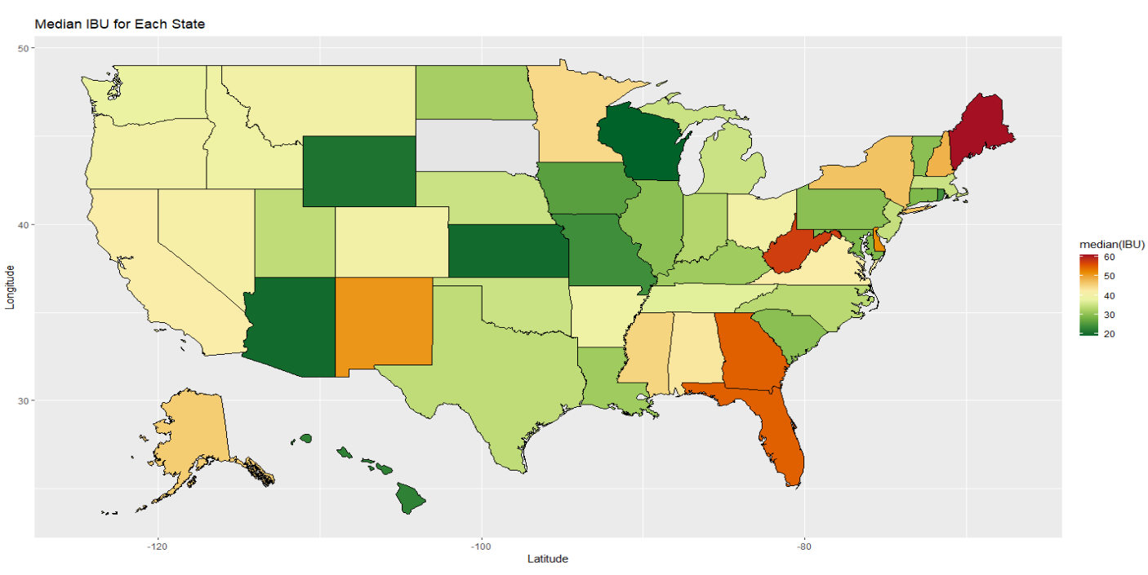
Median IBU for Each State
Maine had the highest ABV median in the USA ~ 61
Max IBU is 138 in OR

